Slide 1

Disaccumulation: Converting Aggregated Forecasts to Fine-Grained Time Periods
Ivan Fomin
GitHub: https://github.com/AGreatGreyMouse/ADB_2025_PROJECT_RETAIL/DA

Slide 2

The Challenge: Temporal Granularity Mismatch
Demand forecasts are frequently generated at aggregated time levels, such as monthly or quarterly. However, critical business operations and planning often require these forecasts at a finer granularity, like weekly or daily.
Forecasts generated at aggregated levels (monthly, quarterly)
Business operations demand finer granularity (weekly, daily)
Need to split aggregated forecasts while preserving total values
Maintain accuracy when distributing forecast values across periods

Slide 3
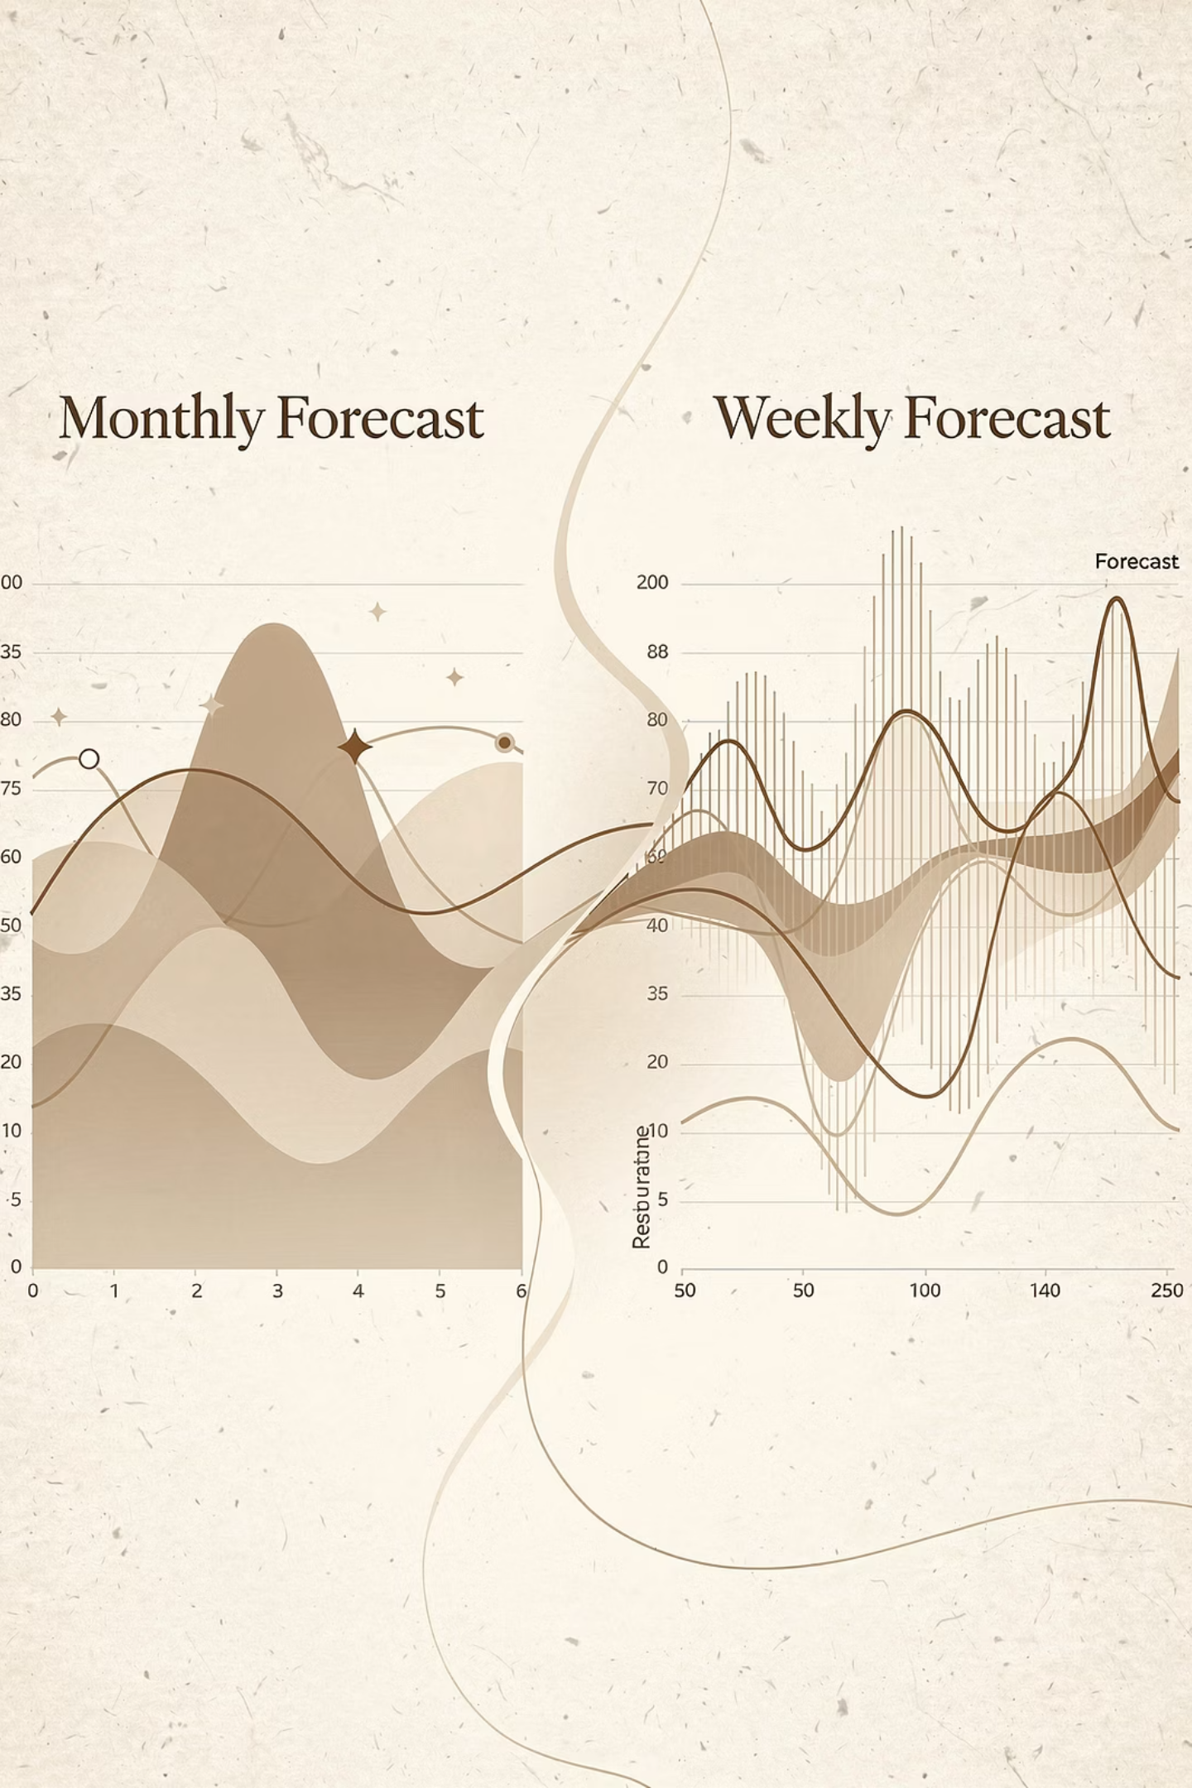
Disaccumulation: Definition & Purpose
Converting Granularity
Disaccumulation is the precise process of converting forecasts from coarse to fine temporal granularity, ensuring data integrity.
Splitting Aggregated Periods
It systematically splits aggregated time periods (e.g., monthly) into smaller, more actionable segments (e.g., weekly or daily).
Proportional Distribution
Forecast values are proportionally distributed across these finer periods, based on their respective time durations.
Value Preservation
Critically, this process preserves the total forecast values across all forecast types (e.g., statistical, machine learning, hybrid models).

Slide 4





Core Capabilities
Multi-level Support
Automatic Detection
Proportional Distribution
Handles Daily (D), Weekly (W.2 = Monday start), and Monthly (M) periods for flexible planning.
Intelligently checks if input data already matches the target granularity, optimizing processing.
Accurately splits forecast values by day count within each sub-period.
Multiple Forecast Types
Lifecycle Integration
Processes VF_FORECAST_VALUE, ML_FORECAST_VALUE, and HYBRID_FORECAST_VALUE simultaneously.
Provides a robust framework for product, location, and customer lifecycle filtering.

Slide 5
Disaccumulation Algorithm Flow
01
02
03
Granularity Check
Period Splitting
Value Distribution
Validates if the input forecast periods align with the desired target granularity.
If a mismatch is detected, each aggregated period is divided into target time buckets.
Calculates the proportional share of the forecast value for each newly created sub-period.
04
05
Lifecycle Filtering
Output Generation
Applies specific product, location, and customer lifecycle constraints to refine the data.
Delivers the refined forecasts at the precisely defined target granularity.

Slide 6
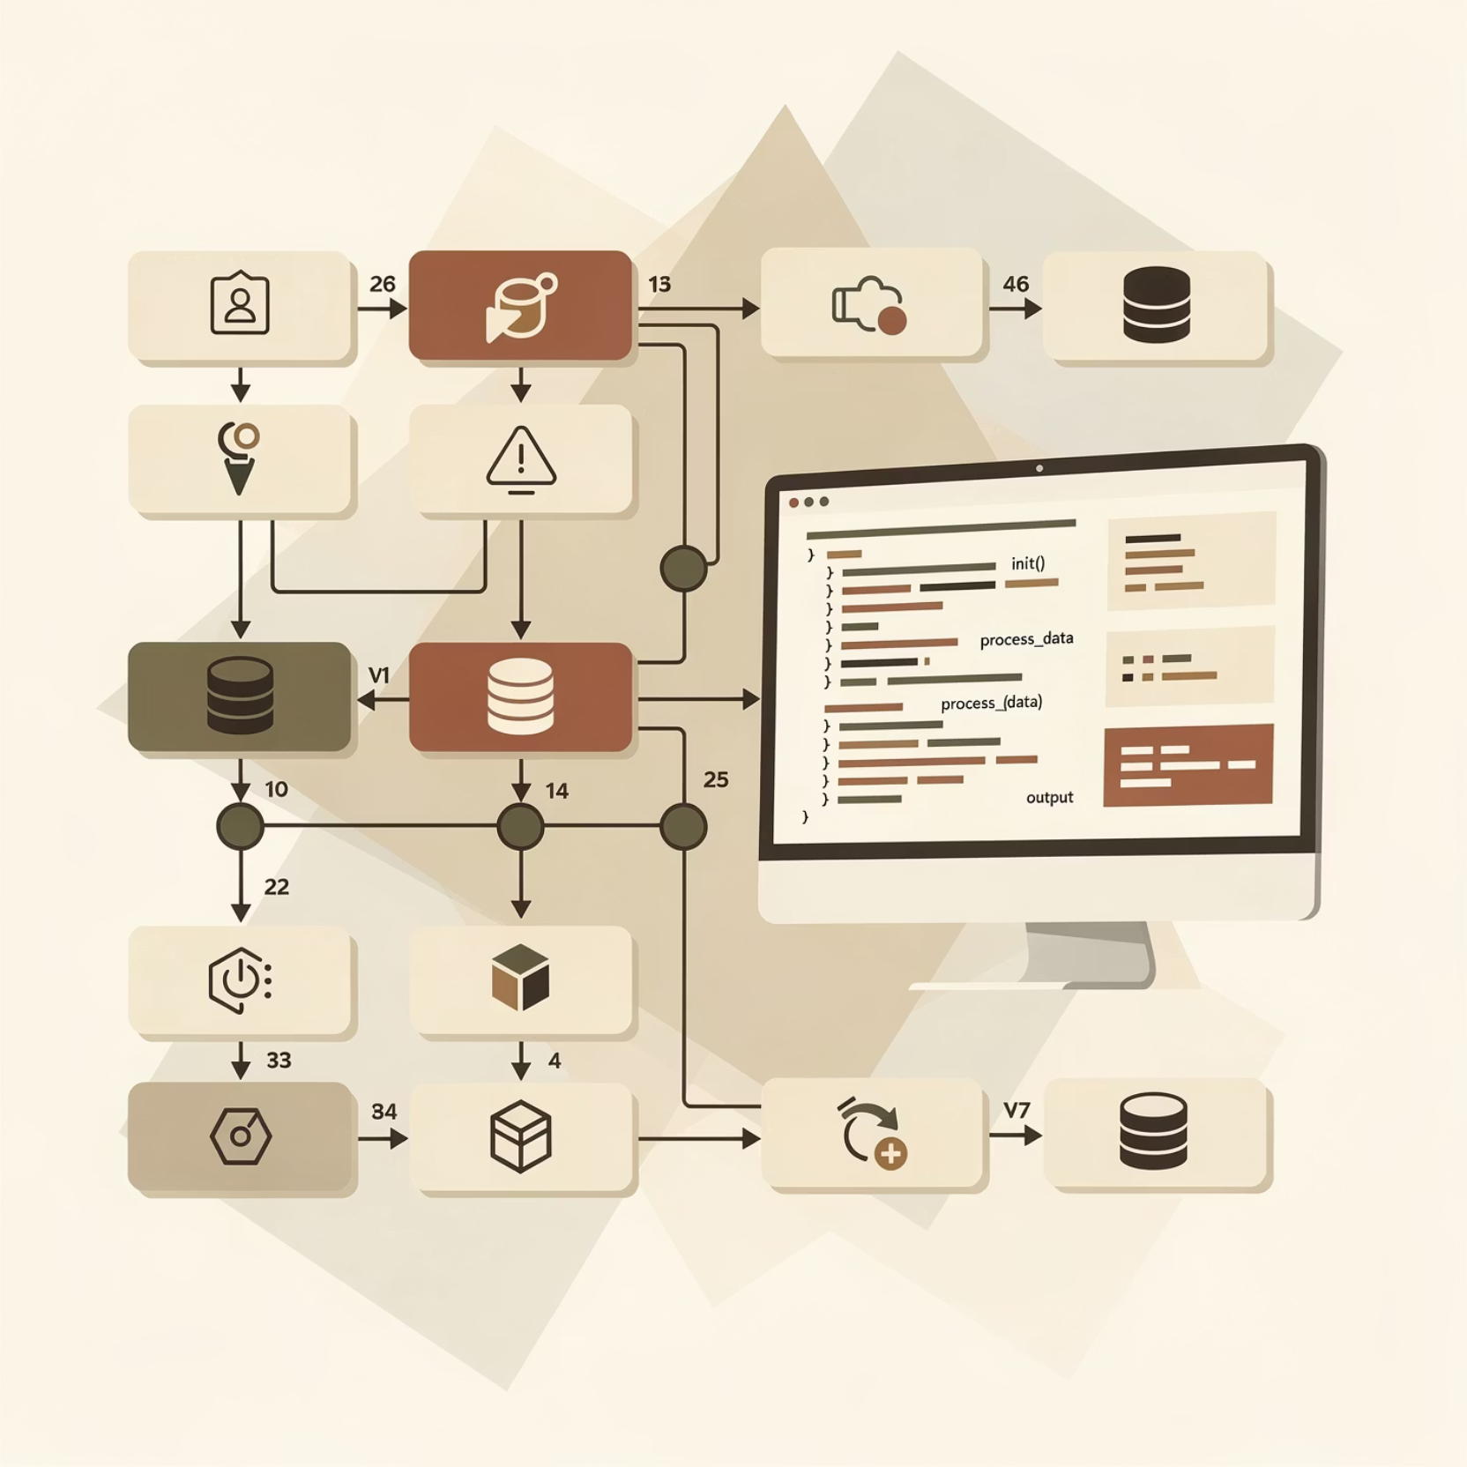
Technical Architecture
Modular Design for Robustness
Class-based Design: A dedicated Disaccumulation class with modular methods for clarity and maintenance.
Period Calculation: Smart date handling, specifically for weekly boundaries (W.2 = Monday start).
Proportional Formula: forecast_value × (sub_period_days / original_period_days) ensures accurate distribution.
Data Preservation: Maintains all crucial dimensional attributes (Product, Location, Customer, Channel).
Performance: Efficient row-by-row processing with integrated progress tracking for large datasets.

Slide 7


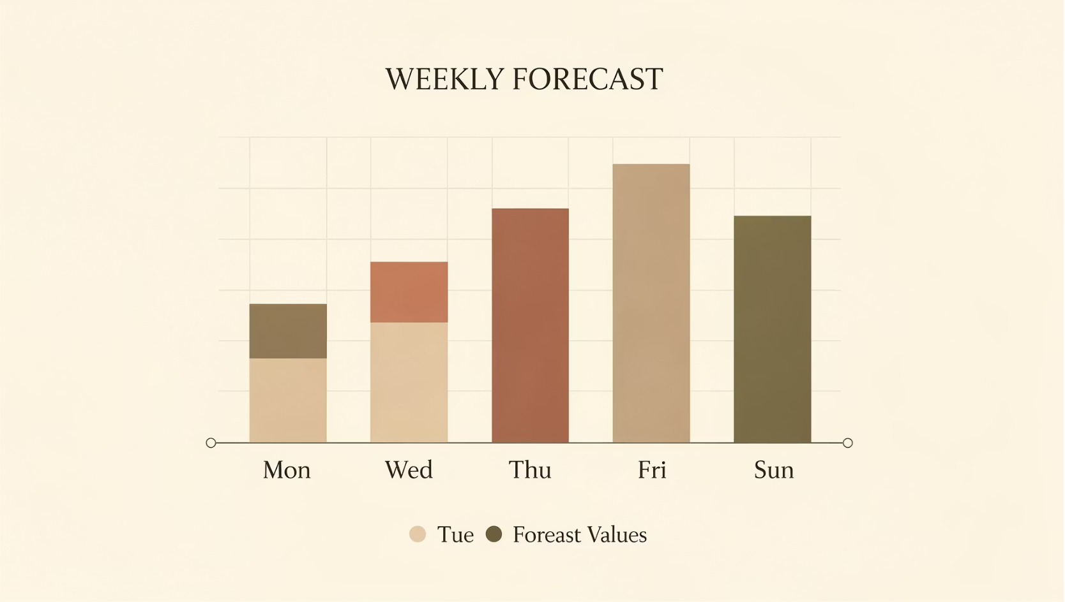























Real-World Application
Input: Monthly Forecast
1
Monthly forecast for Jan 2 - Feb 1, 2015, totaling 100 units.
2
Target: Weekly Granularity
Convert to weekly forecasts, with weeks starting on Monday (W.2).
Process: Splitting & Distribution
3
The monthly period is split into 4-5 distinct weekly periods.
4
Output: Weekly Forecasts
Weekly forecasts generated with proportional values (e.g., 23.33, 23.33, 23.33, 30.01 units).
5
Validation: Total Preserved
The sum of weekly values equals 100 units, demonstrating total preservation.

Slide 8



Time Granularity Support
Daily (D)
Weekly (W.2)
Monthly (M)
Forecasts represented as single day periods, providing the highest level of detail.
Weeks starting on Monday, with configurable day of week options for greater flexibility.
Forecasts aligned with calendar month boundaries for traditional reporting and planning.
Flexible Boundaries
Cross-boundary Splitting
Handles partial periods at the start or end of specified ranges.
Correctly processes and splits periods that span across multiple target buckets.
Ensures accurate distribution even when periods don't perfectly align.
Maintains continuity and accuracy throughout the transformation.

Slide 9
Data Integrity & Testing
1
2
3
Value Preservation
Date Validation
Type Checking
Total forecast values are rigorously maintained across all splits and transformations.
Strict checks ensure that PERIOD_DT is always less than or equal to PERIOD_END_DT.
Validation of datetime formats and data types prevents inconsistencies and errors.
4
5
Comprehensive Testing
Edge Cases
Unit tests verify granularity detection, splitting logic, and value distribution under various scenarios.
Thorough handling of already-correct granularity, partial periods, and boundary conditions ensures robustness.

Slide 10






Key Takeaways
Flexibility
Seamlessly convert forecasts between any temporal granularity levels.
Accuracy
Proportional distribution methods maintain forecast integrity and reliability.
Automation
Eliminates manual forecast splitting, significantly reducing errors and effort.
Scalability
Handles large datasets efficiently with integrated progress tracking for robust performance.
Integration
Seamlessly fits into your existing end-to-end forecasting pipeline, enhancing overall capabilities.

